Slide 1
Prudential Life Insurance Evaluator
Trupti Gore

Slide 2
Project Details
Insurance Data Set
Predict the response using different Regression techniques :
Linear Regression
SVM Regression
Decision Tree Regression

Slide 3
Input : Train data set for Prudential Life Insurance
Train and Test data : Extracted the last 10000 entries in the data set of the given train data set and set it as Test data for prediction
Variable Types : Categorical data, Continuous data and Discrete.

Slide 4
Pre-processing
Pre-processing forms a major part of the data prediction which is done over a number of stages :
Handling Missing Values –
Deleted Columns – Missing values for a column over 60%
Replace Missing values : Continuous Variables – average/mean value of column
1 to C coding – Categorical -> Numerical
Normalization – Already normalized.
Dimensionality Reduction – Applied PCA

Slide 5
3 Regression Techniques considered
Target
Linear Regression
Decision Tree Regression
SVM Regression

Slide 6
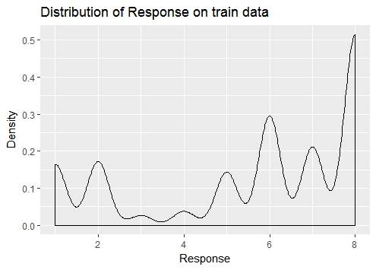
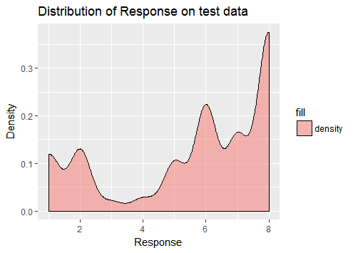
Linear Regression

Slide 7
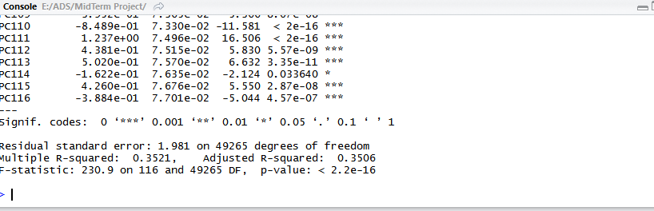
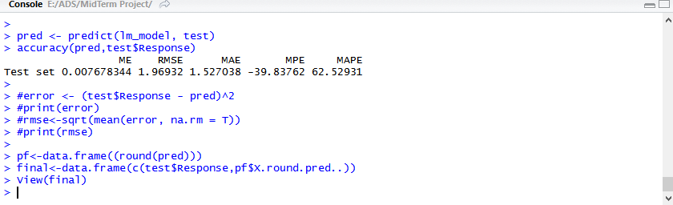
Summary for Linear Regression
Error Summary for Linear Regression

Slide 8
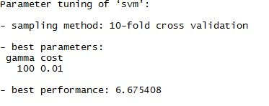
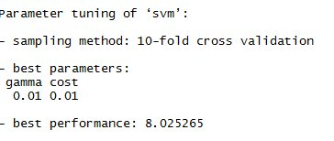
SVM Regression
Tuning to find Best Kernel and parameters
Polynomial Kernel
Sigmoid Kernel

Slide 9
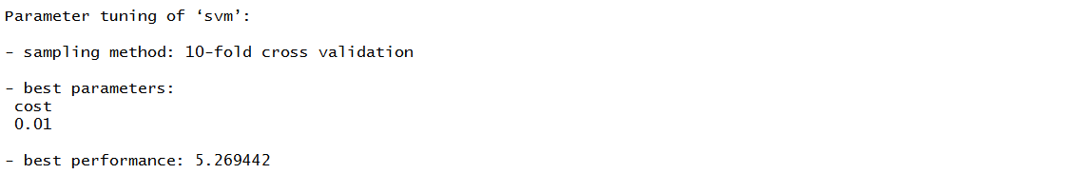
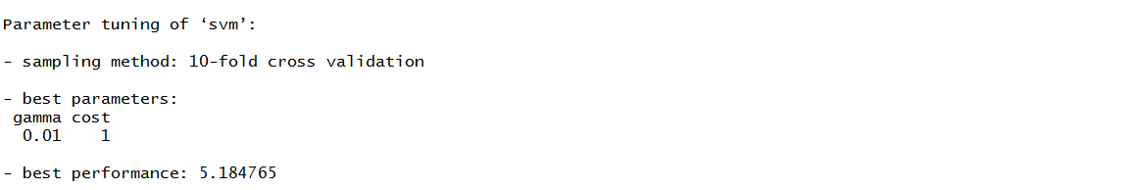
Linear Kernel
Radial Kernel

Slide 10

Best Kernel Decision
Lowest Best Performance → Best Kernel : Radial
Accuracy for SVM :

Slide 11
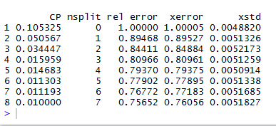
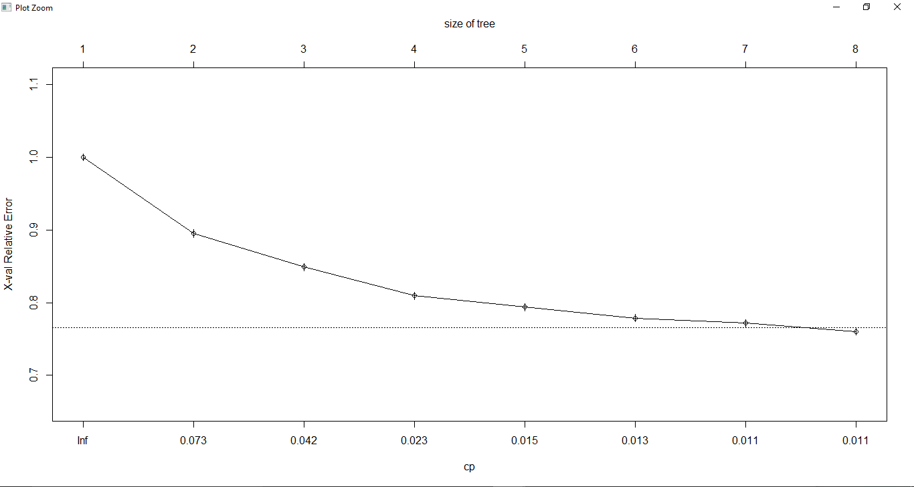
Decision Tree
CP Values
CP values Plot

Slide 12
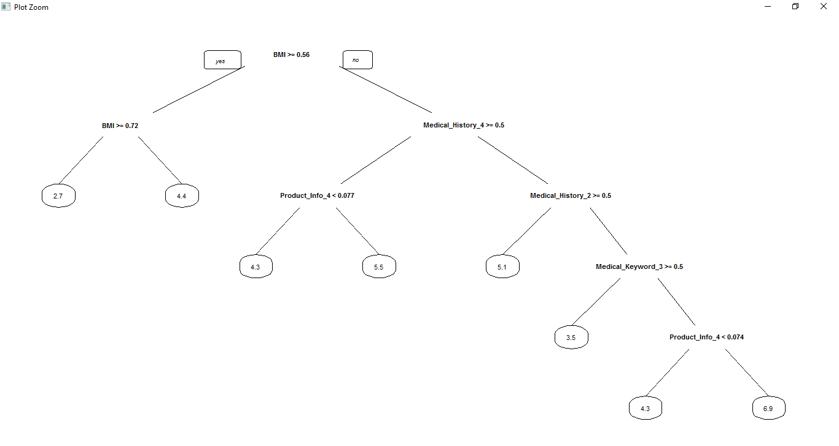
Decision Tree

Slide 13

Accuracy for Decision Tree Prediction

Slide 14
Conclusion
Type of Regression | RMSE Value
Linear Regression | 1.969
SVM | 2.147
Decision Tree | 2.134
Upon comparing RMSE values for each of the regression techniques, it can be concluded that Linear Regression method was the best regression technique suitable for this data set with the least RMSE of the three techniques which is 1.969

Slide 15
Thank You

